Slide 1

JavaScript
Shohel Rana
Lead frontend engineer
Dhaka, Bangladesh
Email: iamshohelrana@gmail.com
Lesson 3

Slide 2
What is a function ?
“A reusable piece of code that is designed to perform a particular task”
N. B: Now, with modern applications, functions can be a complete program in itself, rather than the general notion of a “subprogram”.

Slide 3
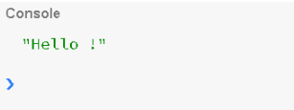
Function that does not take a parameter and doesn’t return anything.
function sayHello () { console.log("Hello !"); }
sayHello();

Slide 4
If you are using es6/es2015 then the same function can be written as an arrow function.
const sayHello = () => { console.log("Hello !"); }
sayHello();

Slide 5
A function that does take a parameter but doesn’t return anything
function log (message) { console.log (message); }
log ("Hello JavaScript!");
NOTE: If the function doesn’t return any value explicitly, then by default it returns “undefined”

Slide 6
A function that takes a parameter and returns a value.
function square(number) { return number * number; }
console.log(square(2));

Slide 7
Functions are first class objects
const square = function (number) { return number * number; }
Let’s write the above function as an arrow function.
const square = (number) => { return number * number; }
console.log(square(2));

Slide 8
How to write a function that can take ’n’ arguments?
// Old way const sum = function () { let result = 0; for(let i = 0; i < arguments.length; i++) { result += arguments[i]; } return result; }
console.log(sum(1,2)); console.log(sum(1,2,3,4)); console.log(sum(1,3,5,7,9));

Slide 9
What does …args does ?
const sum = function (...args) { console.log(args); let result = 0; result = args.reduce((current, prev) => { return current + prev; }); return result; }
sum(1,2,3,4,5);

Slide 10
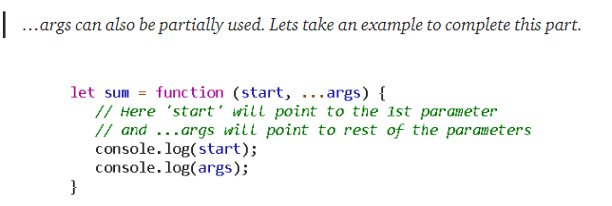

Slide 11
A function taking ‘function’ as a parameter
function dispatch (fn) { fn(); }
NOTE: We will use the term ‘callback’ when we are referring to functions that take function as a parameter.

Slide 12
A function can call itself (aka recursion)
function runForEver() { runForEver(); }
// You can invoke the above function by running runForEver(); // If you try you will get the call stack error

Slide 13
Immediately Invoked Function Expression aka IIFE
function () { let message = "I don't have a name"; console.log(message); }
Now, let’s see how to execute the above anonymous function.
(function () { let message = "I don't have a name"; console.log(message); })();

Slide 14
Where can IIFE be used?
Objects and Functions (call, apply and bind)
call
bind
apply

Slide 15
let user = { userName: "codingmonk", displayName: "rajesh", sendMessage: function (message) { console.log(`Sending ${message} to ${this.displayName}`); } }
let student = { displayName: "rohan“
} }

Slide 16
Using call() user.sendMessage.call(student, “Hello from Rajesh”);
Using apply() user.sendMessage.apply(student, [“Hello from Rajesh agin..”]);
Using bind() let sendMessageToStudent = user.sendMessage.bind(student);

Slide 17
Constructor Function
function User (name, email) { this.name = name; // instance variables this.email = email; this.save = function () { this.id = +new Date(); //console.log(`${this.name} saved to DB successfully!`); return this.id; } }
let user = new User('rajesh', 'someemail@test.com');

Slide 18
Why use a prototype for adding instance methods?
let users = []; for(let i = 1; i <= 100; i++) { let user = new User(`user ${i}`); user.email = `user${i}@test.com`; // Lets create dynamic email users.push(user); }
console.log(users);

Slide 19
How to return a custom object from a Constructor function?
function Api(baseUrl) { let _secret = +new Date(); let self = this; // in case you access to 'this' of Api.
return { fetchData: function (resource) { let url = `${baseUrl}/${resource}/`; console.log(url); fetch(`${url}`) . then(response => response.json()) .then(json => console.log(json)); } } }

Slide 20
Singleton
var Singleton = (function () { var instance;
function createInstance() { var object = new Object("I am the instance"); return object; }
return { getInstance: function () { if (!instance) { instance = createInstance(); } return instance; } }; })();

Slide 21
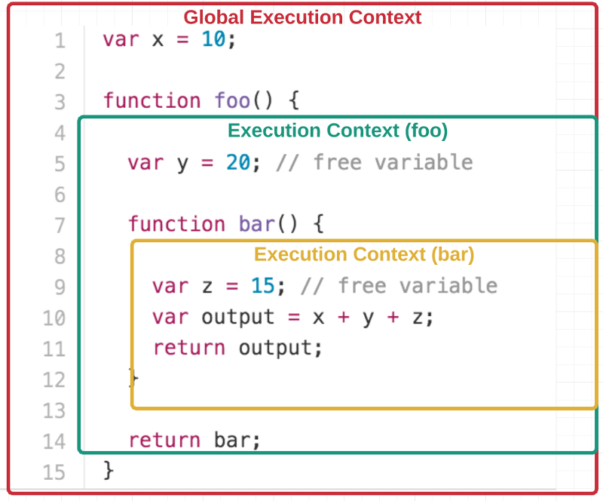
Closures
A closure is the combination of a function and the lexical environment within which that function was declared.

Slide 22

Thank you today

